Slide 1
Algorithm Analysis Part 2

Slide 2
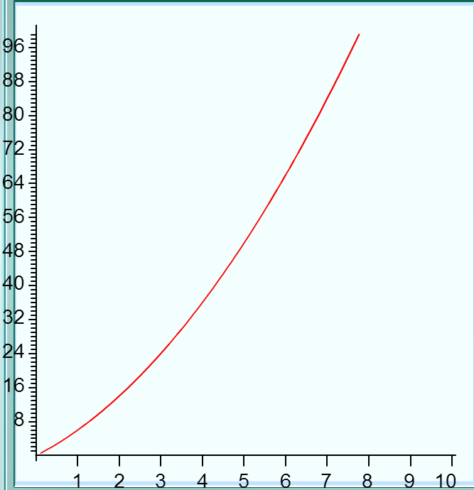
Visualizing Big O
How can we describe the graph?
Notes:
How can we describe this line?

Slide 3
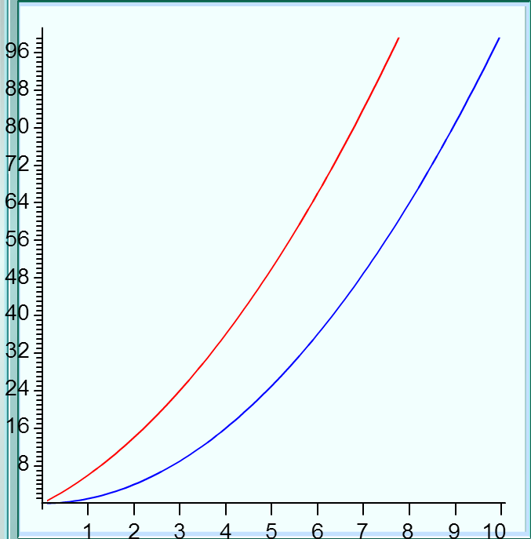
Is it x^2?
Note Quite!
Notes:
How can we describe this line?

Slide 4
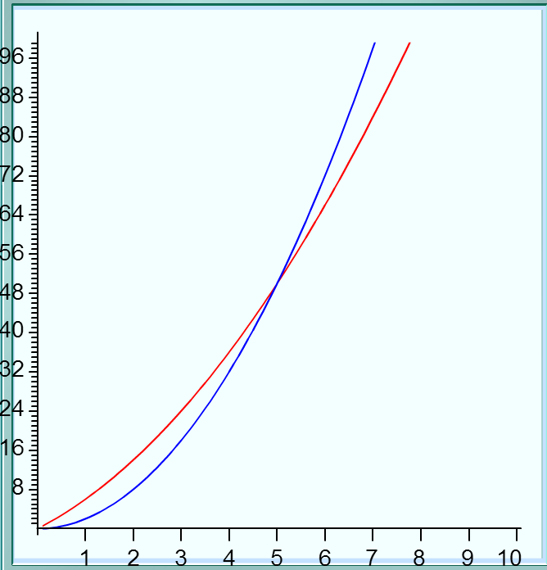
Perhaps try 2*x^2?
Better (close enough)
Notes:
How can we describe this line?

Slide 5
Perhaps try 2*x^2?
Big O tries to find a line such that for every x1 > x0, g(x) >= f(x)
Notes:
How can we describe this line?

Slide 6
Perhaps try 2*x^2?
Therefore, this line is O(N^2)
Notes:
How can we describe this line?

Slide 7
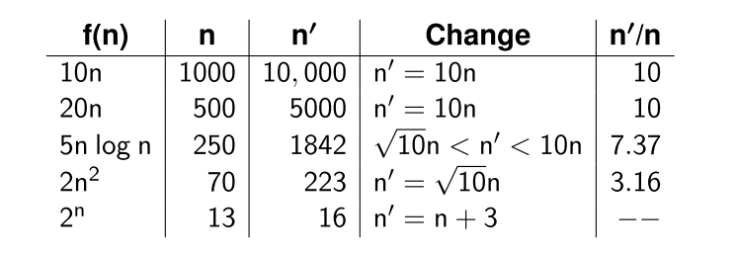
What a 10x increase in computer performance would yield in terms of algorithmic performance:

Slide 8
You try
If f(n) is some function and f(100) takes 1 second, how much would it take to compute f(200) if:
F(n) is O(LogN)
F(n) is O(n)
F(n) is O(NLogN)
F(n) is O(N^2)

Slide 9
When analyzing algorithms that call other functions, be sure to take into consideration the growth rate of that function.
void foo (LinkedList<int> &my_list)
{
if(my_list.size() > 10)
{
cout << "more than 10";
}
else
{
cout << "less than 10";
}
}

Slide 10
Determining efficiency of recursive algorithms can be tricky.
void factorial(int x)
{
switch(x)
{
case 0:
case 1:
return 1;
break;
default:
return x * factorial(x – 1);
break;
}
}

Slide 11
void search(int *sorted_list, int size, int to_find)
{
int index = size / 2;
if(size == 0)
return -1;
if(sorted_list[index] == to_find)
return index;
else if(sorted_list[index] > to_find)
return search(&sorted_list[index + 1], index - 1, to_find);
else
return search(sorted_list, index, to_find);
}

Slide 12
Real-world algorithm analysis problems
Flipping a coin and determining whether it is heads or tails
O(1)
O(Log(N))
O(N)
O(N * Log(N))
O(N^2)
Other

Slide 13
Real-world algorithm analysis problems
Reading a book from cover to cover
O(1)
O(Log(N))
O(N)
O(N * Log(N))
O(N^2)
Other

Slide 14
Real-world algorithm analysis problems
Checking to see if you've gotten everything on your shopping list.
O(1)
O(Log(N))
O(N)
O(N * Log(N))
O(N^2)
Other

Slide 15
Real-world algorithm analysis problems
Finding a word in a dictionary
O(1)
O(Log(N))
O(N)
O(N * Log(N))
O(N^2)
Other

Slide 16
Real-world algorithm analysis problems
Attempting a brute-force crack on an alphanumeric password, assuming only lower case and numbers are allowed.
O(1)
O(Log(N))
O(N)
O(N * Log(N))
O(N^2)
Other

Slide 17
Real-world algorithm analysis problems
Sorting a deck of cards by value (ignore suit)
O(1)
O(Log(N))
O(N)
O(N * Log(N))
O(N^2)
Other

Slide 18
Real-world algorithm analysis problems
Visiting all US state capitals in the shortest amount of distance with no repeat stops starting and ending in Arcata.
O(1)
O(Log(N))
O(N)
O(N * Log(N))
O(N^2)
Other
Notes:
Depending on algorithm, either O(N!) or O(2^n)

